Slide 1
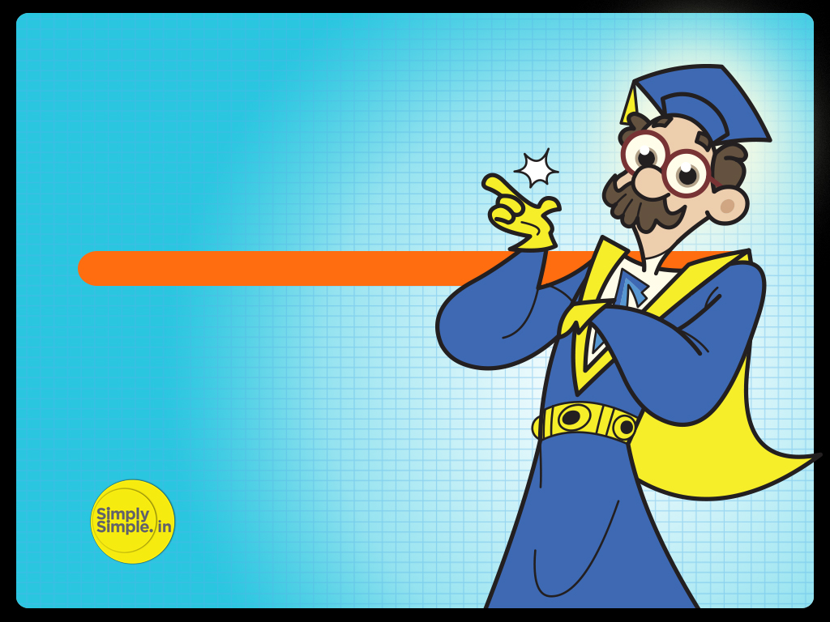

FED TAPERING
WEATHER DERIVATIVES

Slide 2

Understanding ‘Weather Derivatives’ – By Prof. Simply Simple TM

Slide 3

WEATHER DERIVATIVES
In the last few years, the monsoons have played truant on more than one occasion.
But what if your business depended on a good and timely monsoon?

Slide 4

WEATHER DERIVATIVES
Lets understand how “Weather Derivatives” provide protection against the uncertainties of the weather.

Slide 5

WEATHER DERIVATIVES
Any derivative product derives its value from some underlying asset.
Weather derivatives use weather conditions—such as city temperature, rainfall and wind speed and so on—to create different kinds of derivative instruments.

Slide 6
WEATHER DERIVATIVES
Although you can’t put a price tag on rainfall or temperature, weather conditions do fluctuate like the price of your stocks and bonds.
That’s what enables the creation of weather derivatives, which work just like any other derivative.

Slide 7
Sounds quite intriguing, doesn’t it?
Now let’s understand better through the following example…

Slide 8
WEATHER DERIVATIVES
Let’s say Mr. Kisan is a farmer whose fortunes depend on the arrival of timely monsoons. Also, lets assume that Rs. 600 is his overall cost for plowing, sowing wheat etc.

Slide 9
WEATHER DERIVATIVES
If the monsoons are on time he earns, say, Rs. 1000 & makes a profit of Rs. 400 (Rs. 1000 – Rs. 600).
But if they are delayed, his earnings could reduce to Rs 500.
In this case, he will not be able to even recover his cost of Rs. 600.

Slide 10
WEATHER DERIVATIVES
Therefore, he is willing to spend some money if someone can ensure that he makes some profit irrespective of whether the monsoon is on time or not.

Slide 11
This need for protection gives rise to “Weather Derivative Contracts”.

Slide 12
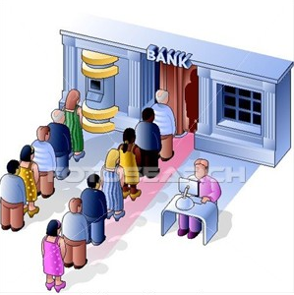
WEATHER DERIVATIVES
So Mr Kisan heads to a bank which offers him a weather derivative contract and is willing to stand guarantee for the same for a cost of Rs 200 which is also known as the ‘premium’.

Slide 13
WEATHER DERIVATIVES
Thus if monsoons are on time, he is able to earn Rs. 1000 out which he pays Rs 200 as premium for the derivative contract.
Thus he still earns Rs 800 ( Rs 1000 – Rs 800).

Slide 14
WEATHER DERIVATIVES
However if the monsoons are not on time, he still receives Rs 1000 as his earnings due to the weather derivative contract drawn between him & the bank.
The bank thus acts as an intermediary, which hedges or protects Mr. Kissan from an unpredictable monsoon.

Slide 15
WEATHER DERIVATIVES
In ‘Weather Derivatives’ two parties have differing points of view on the weather just as in Futures Trading two parties have different points of view on the future price of a stock.

Slide 16
WEATHER DERIVATIVES
In Weather Derivatives both parties achieve their goals of protecting their interests.
While there may be an opportunity loss for Mr. Kissan, he still lands up making a profit of Rs. 200.
At least he would have been at peace for the period before the monsoon since he remained protected against any kind of weather fluctuation.
The bank, on the other hand, charges Rs 200 as risk premium.
It earns this money if the weather turns out as per its expectation but in case the weather fails, it would lose Rs 800 (Rs 1000 – Rs 200).

Slide 17
WEATHER DERIVATIVES
However we need to understand that the bank too hedges its risk by selling these products to different people having exactly the opposite view as well.

Slide 18
WEATHER DERIVATIVES
In the real world, imagine there are several farmers in the market who want the monsoon to come on time.

Slide 19
WEATHER DERIVATIVES
So they buy ‘Weather Derivative’ products as a hedge and pay a premium to the bank.

Slide 20
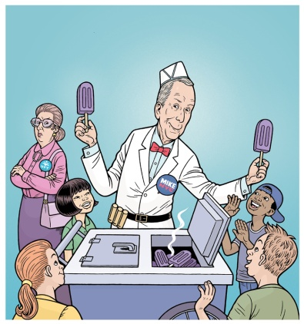
WEATHER DERIVATIVES
Similarly there are other people like ice cream sellers who actually do not want the rains to come on time. A delay in monsoon extends their selling season and consequently sales and profits!

Slide 21

WEATHER DERIVATIVES
So the ice cream maker too buys weather derivative products from the bank to hedge himself from early monsoon season. Thus, if the monsoons arrive early the bank protects him against losses.

Slide 22
WEATHER DERIVATIVES
Let’s say the ice cream seller earns Rs 1000 as profit in a good season and Rs 500 as profit during the monsoons.
Since he wants to hedge himself against early monsoons & not lose out on the remaining Rs. 500, he buys the weather derivative products at, say, Rs 300 to hedge him against losing the remaining Rs. 500.

Slide 23
Now let’s look at two different scenarios…

Slide 24
WEATHER DERIVATIVES
Scenario A: The monsoons come early
In this case, he makes only Rs. 500. But as he gets protected by the derivative product for the remaining Rs. 500, he earns Rs 1000 in total.
However since he has paid Rs 300 for the derivative product, his net earning is Rs 700 which is still better than the
Rs 500 which he would have otherwise made.

Slide 25
WEATHER DERIVATIVES
Scenario B: The monsoon arrives on time (and not early)
In this case, while he makes Rs. 1000 as his normal profit, he stands to lose his premium of Rs 300 but again makes a net profit of Rs 700
(Rs 1000 – Rs 300)

Slide 26
WEATHER DERIVATIVES
In this way the ice-cream seller also hedges (protects ) his interests from the vagaries of the weather by way of weather derivative products

Slide 27
WEATHER DERIVATIVES
Having people with opposite expectations helps the bank hedge their risks as well.
If rains get delayed, the bank loses out on the farmers but gains from the ice-cream sellers.
Conversely if the rains come early, the bank loses out on the ice-cream sellers but gains from the farmers.

Slide 28
WEATHER DERIVATIVES
Thus we have seen how weather derivatives are used by different types of people with different expectations for their benefits!

Slide 29
WEATHER DERIVATIVES’ (EXTENDED VERSION)
Hope this lesson has succeeded in further clarifying the concept of ‘Weather Derivatives’

Slide 30

Please give your feedback at
professor@tataamc.com

Slide 31

DISCLAIMER
The views expressed in this lesson are for information purposes only and do not construe to be any investment, legal or taxation advice. The lesson is a conceptual representation and may not include several nuances that are associated and vital. The purpose of this lesson is to clarify the basics of the concept so that readers at large can relate and thereby take more interest in the product / concept. In a nutshell, Professor Simply Simple lessons should be seen from the perspective of it being a primer on financial concepts. The contents are topical in nature and held true at the time of creation of the lesson. This is not indicative of future market trends, nor is Tata Asset Management Ltd. attempting to predict the same. Reprinting any part of this material will be at your own risk. Tata Asset Management Ltd. will not be liable for the consequences of such action.
Mutual Fund investments are subject to market risks, read all scheme related documents carefully.

Slide 32
DISCLAIMER
The views expressed in this lesson are for information purposes only and do not construe to be any investment, legal or taxation advice. The lesson is a conceptual representation and may not include several nuances that are associated and vital. The purpose of this lesson is to clarify the basics of the concept so that readers at large can relate and thereby take more interest in the product / concept. In a nutshell, Professor Simply Simple lessons should be seen from the perspective of it being a primer on financial concepts. The contents are topical in nature and held true at the time of creation of the lesson. This is not indicative of future market trends, nor is Tata Asset Management Ltd. attempting to predict the same. Reprinting any part of this material will be at your own risk. Tata Asset Management Ltd. will not be liable for the consequences of such action.
Mutual Fund investments are subject to market risks, read all scheme related documents carefully.

